Slide 1







Medical Diagnosis Decision Support System
Master in Artificiel lntelligence
Supervisor: Dr. ÖZLEM FEYZA ERKAN
Beykoz University
January 2026

Slide 2












What is This System For?
Helps doctors find out what sickness a patient has
Uses two main ways: Fuzzy Logic and Decision Trees
Helps doctors make better choices when they:
Don't have all information
Need to decide quickly
Face similar sicknesses
Want to reduce mistakes
Medical Diagnosis Decision Support System
Page 2 of 20

Slide 3












Why This Research is Important
This research wants to:
Make Diagnosis Better
Help Faster
Improve Healthcare
Help doctors find the right sickness
Get patients the right help quickly
Make medical systems work better
How Our System Helps:
Easy AI that doctors can understand
Helps doctors make better choices
Helps doctors understand sicknesses
Medical Diagnosis Decision Support System
Page 3 of 20

Slide 4









Problems Doctors Face Every Day
Missing Information
No Time
Doctors sometimes don't have all the patient's details. This can make it hard to know what is wrong.
Doctors often need to make quick decisions. They can't take all the time they want.
Similar Sicknesses
Human Mistakes
Many sicknesses have signs that look the same. This makes it hard to tell which sickness a patient has.
Even good doctors can make mistakes. This can happen when they are tired or stressed.
Medical Diagnosis Decision Support System
Page 4 of 20

Slide 5








Research Questions We Want to Answer
We want to make AI systems that help doctors diagnose patients better. Here are the four main questions:
Question 1:
Question 2:
How can AI systems be more correct in finding sicknesses?
How can AI systems work faster without making more mistakes?
Diagnostic Accuracy
Prediction Speed
Question 3:
Question 4:
How can we make AI decisions easier for doctors to understand?
How can AI systems work well for different patients and medical situations?
Explainability
Medical Adaptation
Our Idea: New systems that mix smart computer learning with known rules will work better than old systems.
Medical Diagnosis Decision Support System
Page 5 of 20

Slide 6














How We Did This Research
Our Research Process
How We Measured Success
We used 250 patients
Accuracy
Precision
We collected information from 250 patients
How often the system is right
How exact the system's predictions are
We checked 9 details
We looked at 9 important patient details
Recall
F1-Score
We looked for 4 sicknesses
How well the system finds all sicknesses
A mix of precision and recall
We searched for 4 types of sicknesses
We compared methods
We used two groups: control and test
Medical Diagnosis Decision Support System
Page 6 of 20

Slide 7
















How Our System Works
Processing Layer
Input Layer
Has two smart computer brains
Output Layer
Collects patient information
Shows results to doctors
Patient records
Fuzzy Logic Engine
Sickness diagnosis
For diagnosis
Lab test results
Treatment suggestions
Decision Tree Engine
For treatment
Information moves through the system and learns from experience
Medical Diagnosis Decision Support System
Page 7 of 20

Slide 8


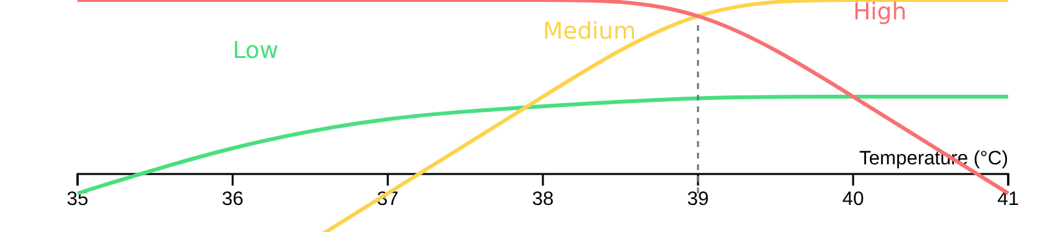












Fuzzy Logic System Explained
Fuzzy Logic thinks like people
Fever Example
Temperature:
39°C
Understands "a little bit" or "somewhat" sick
Not just "yes" or "no" - uses degrees of truth
Uses numbers from 0.0 to 1.0
Fuzzification
Rule Evaluation
Defuzzification
0.0 = "not true" | 1.0 = "very true"
39°C → "High Fever"
IF Fever is High...
"High Fever" → Decision
Fuzzy Logic is good at handling unclear information
Medical Diagnosis Decision Support System
Page 8 of 20

Slide 9









Decision Tree System Explained
How Decision Trees Work
Works like a flowchart with questions and answers
Has nodes (questions), branches (answers), and leaves (final diagnosis)
Fever?
Each path from start to leaf is a rule
Shows the steps it takes to make a decision
Learns from many patient examples
Medical Diagnosis Decision Support System
Page 9 of 20

Slide 10

















How Decision Tree Learns
1
Get Data Ready
2
Choose Best Details
3
Find Split Points
4
Build the Tree
5
Make it Better
System takes patient information and prepares it for learning
Finds most important patient details to use for decisions
Finds best numbers to divide patient groups
Keeps making new questions and branches until it can guess well
Makes the tree simpler so it doesn't make mistakes on new patients
Medical Diagnosis Decision Support System
Page 10 of 20

Slide 11















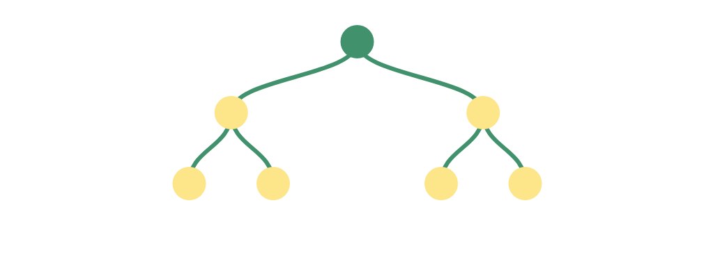
Settings for Our Decision Tree
We set special rules to make sure our tree works well and doesn't make mistakes on new patients.
Max Tree Depth
Gini Impurity
Samples per Leaf
Maximum 5 nodes deep
Chooses the best questions
Minimum 10 patients
Prevents the tree from being too big and making too many mistakes
Helps the tree split patient groups correctly
Each final group must have at least 10 patients
Feature Selection
Regularization
Decision Tree
Chooses important details
Prevents overfitting
Helps select which patient details are most important
Helps the tree work well on new patients
Medical Diagnosis Decision Support System
Page 11 of 20

Slide 12


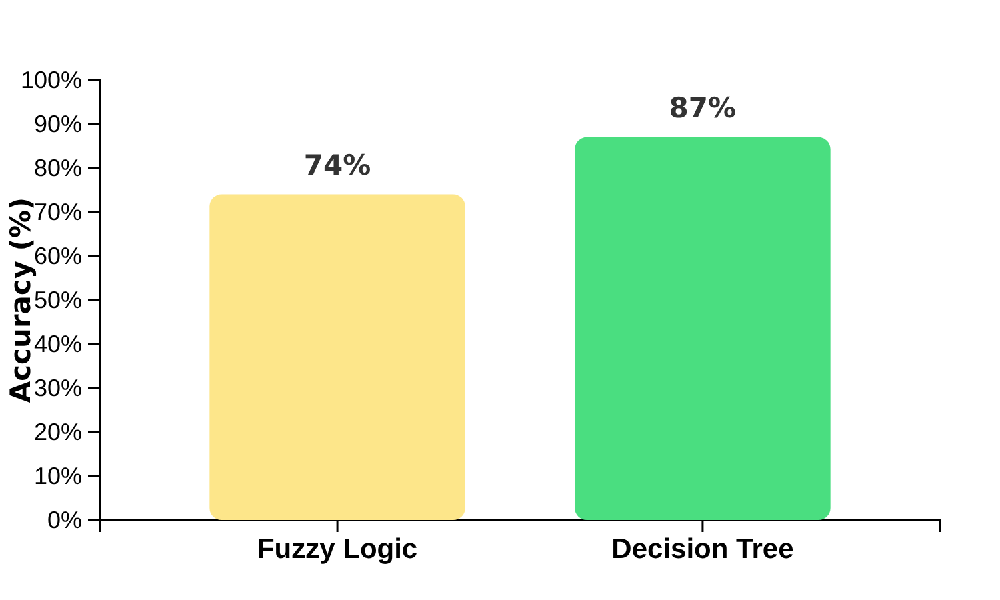







What We Found in Our Tests
Main Findings
Accuracy Comparison
Decision Trees were more correct (87%) than Fuzzy Logic (74%)
Decision Trees were faster (2.3 times) than Fuzzy Logic
Decision Trees had better recall (89%) than Fuzzy Logic (71%)
Decision Trees had better precision (86.8%) than Fuzzy Logic (80.1%)
Decision Trees were 6.7% better than Fuzzy Logic
This difference was important and not by chance
Medical Diagnosis Decision Support System
Page 12 of 20

Slide 13

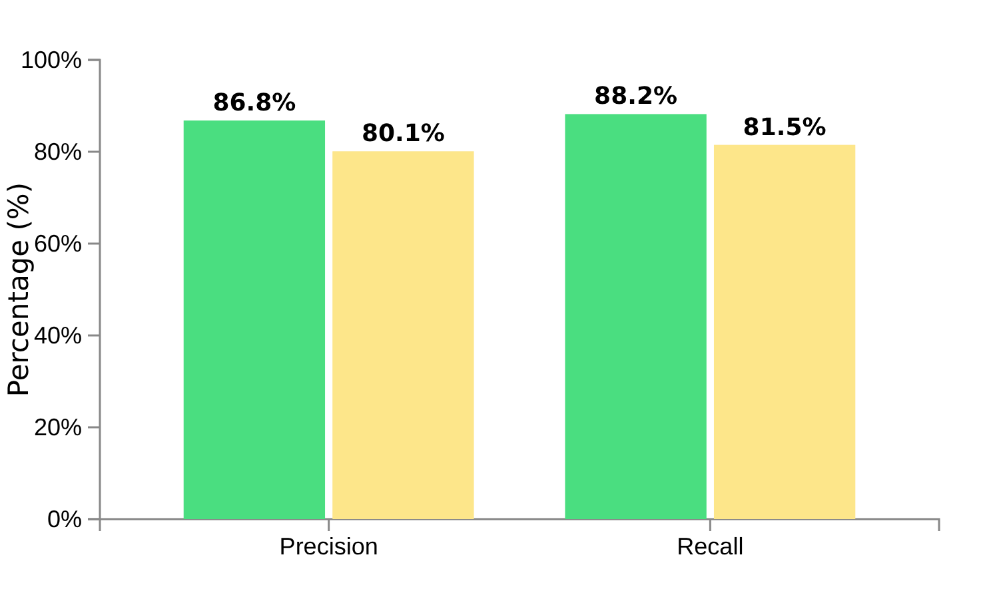











Comparing System Performance
Performance Metrics Comparison
Key Findings
Decision Tree had better precision (86.8% vs 80.1%)
Decision Tree had better recall (88.2% vs 81.5%)
Decision Tree was better by about 6.7% in both metrics
Decision Tree made fewer wrong guesses
Difference was important and not by chance
Decision Tree
Fuzzy Logic
Medical Diagnosis Decision Support System
Page 13 of 20

Slide 14

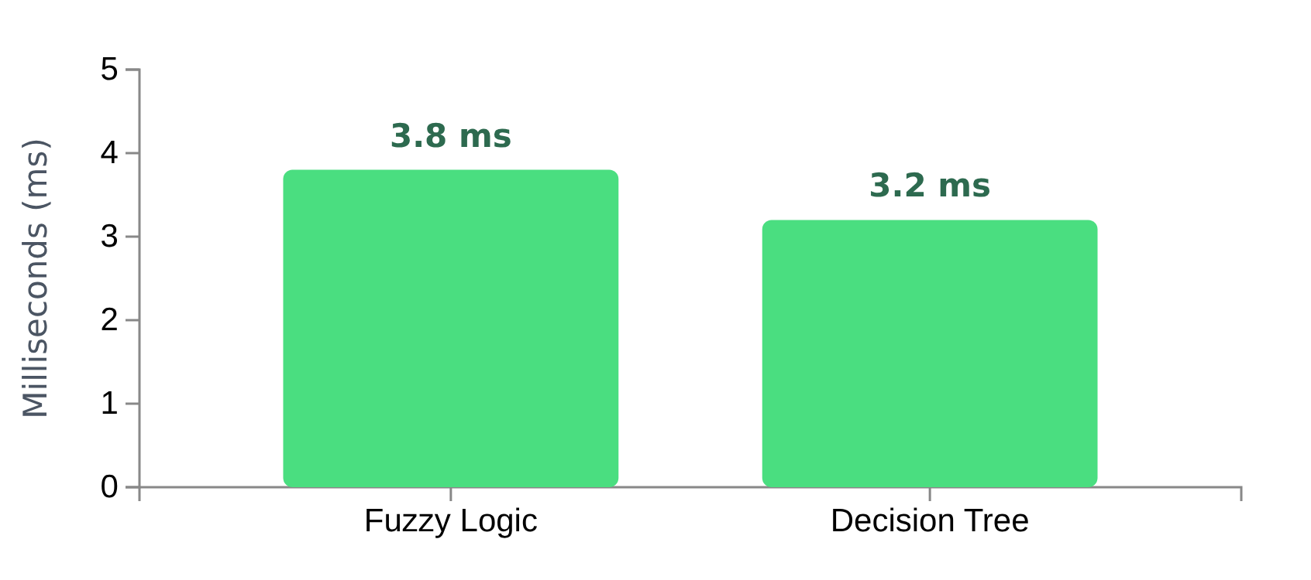



How Fast Are the Predictions
Both systems make decisions in less than 4 milliseconds
They can work on normal hospital computers
They can handle many patients at once
Almost all decisions (99.7%) are made quickly
Processing Time Comparison (milliseconds)
Fast enough for doctors! Doctors can get help right away with these systems.
Medical Diagnosis Decision Support System
Page 14 of 20

Slide 15
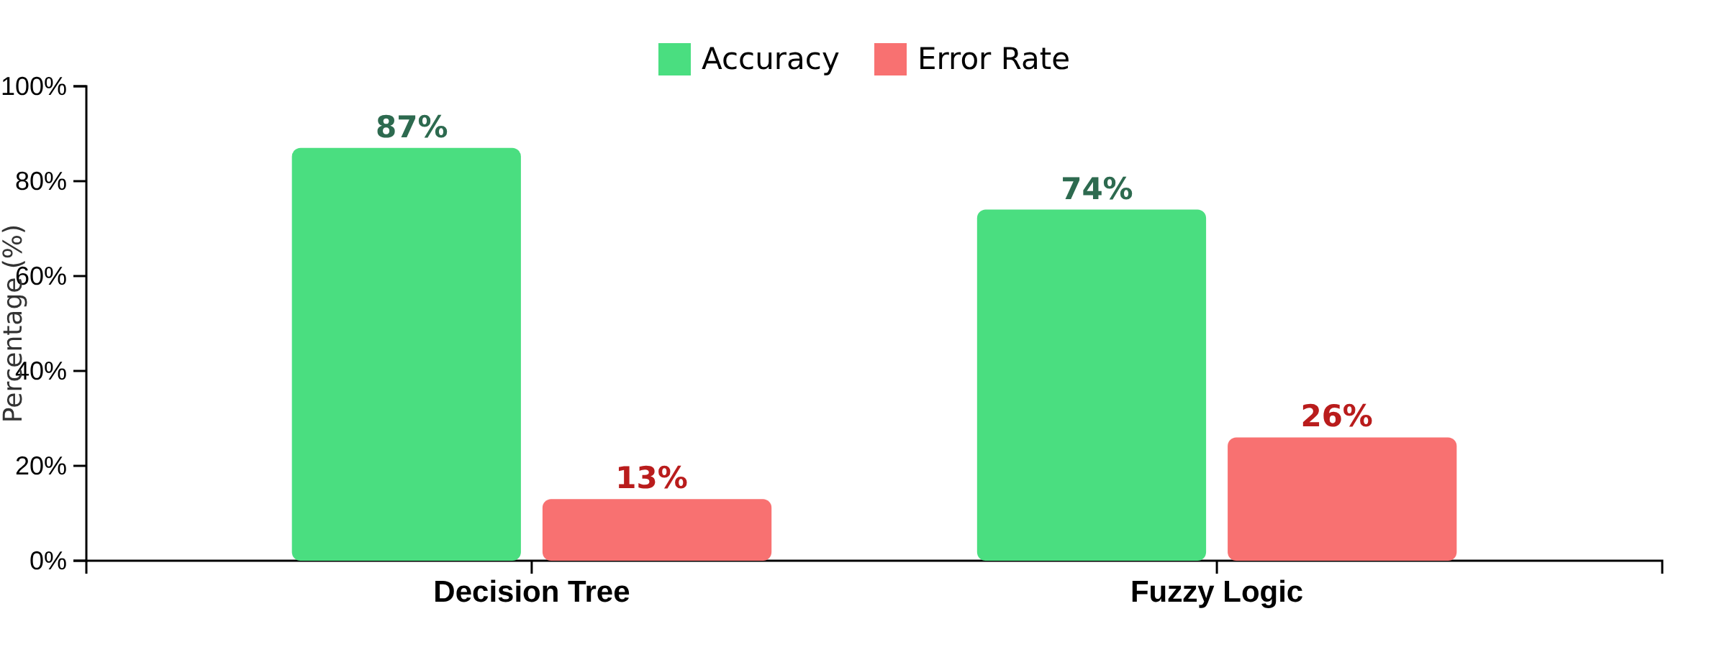




System Accuracy Results
Our tests showed that the Decision Tree system was much more accurate than the Fuzzy Logic system.
Decision Tree: 87% accuracy
Fuzzy Logic: 74% accuracy
Decision Tree better at finding patterns
Difference: 6.25% (statistically significant)
Medical Diagnosis Decision Support System
Page 15 of 20

Slide 16













How Easy to Understand
Why Fuzzy Logic is Easy to Understand
How Fuzzy Logic Explains Decisions
Uses natural language doctors can understand
Example:
Works like doctors think, not just yes/no
Input: Temperature = 39°C
Fuzzy Logic: "Temperature is High"
Helps patients understand their diagnosis
Rule: IF Temperature is High THEN Health is Poor
Output: "Diagnosis: Likely Flu"
You can see how it makes its choices
Fuzzy Logic vs. Traditional Systems
Fuzzy Logic
Traditional Systems
Easy to understand explanations
Hard to understand
Medical Diagnosis Decision Support System
Page 16 of 20

Slide 17











Dealing with Unclear Information
Traditional Systems vs. Fuzzy Logic
How Fuzzy Logic Helps Doctors
Better Temperature Notes
Traditional Systems
Yes/No Answers
"High fever" instead of just "fever"
Only two answers: true or false
Better Lung Measurements
"Partially blocked" instead of just "blocked"
Fuzzy Logic
Degrees of Truth
Like Doctors Think
Works like how doctors understand medicine
0.0 Not true
0.5 Somewhat true
1.0 Very true
Did you know? Fuzzy Logic uses math tools called "membership functions" to decide how much something belongs to a group.
Many answers between false and true
Medical Diagnosis Decision Support System
Page 17 of 20

Slide 18







Good and Bad Points of Each System
Decision Tree
Fuzzy Logic
Very correct in finding sicknesses (87% accuracy)
Easy to understand with words
Works well with different types of data
Better at handling unclear information
Needs more computer power
Less accurate (74% accuracy)
Can make mistakes with unclear data
Can have trouble with complex rules
Best for: Clear, organized data
Best for: Information that is not exact
Medical Diagnosis Decision Support System
Page 18 of 20

Slide 19










Study Limitations and Problems
Small Data
Simple Sicknesses
Only used information from 250 patients. This might not be enough for all types of patients.
Only looked at common sicknesses. Did not test very rare or complex sicknesses.
No Real Hospital Test
Only One Type of Patient
Tested the system in a lab, not in a real hospital with real doctors and patients.
Most patient data was from cities. This might not work for people in the countryside.
Medical Diagnosis Decision Support System
Page 19 of 20

Slide 20










Future Plans and Conclusions
Future Plans
Our Conclusion
Test the system in real hospitals
Smart computer systems help doctors diagnose patients better.
Get more patient data from different places
These systems should be:
Easy for doctors to understand
Make AI systems safer for everyone
Based on real patient data
Fair and safe for all patients
Create easy-to-use screens for doctors
Future success needs more data, mixed AI methods, and real hospital testing.
Medical Diagnosis Decision Support System
Page 20 of 20

